Slide 1
Rheological Study of Honey and Sugar Syrup Mixtures
CH5250 Food Rheology
Prof. Alan Jacob
Harshavardhan Tompe
Vinod Kumar
Yash Vardhan Singh Gahlot
Jawaharlal Banothu
- CH21BTECH11033
- CH21BTECH11035
- CH21BTECH11036
- CH21BTECH11037

Slide 2
How does the addition of sugar syrup affect the viscosity of Honey with shear rate?

Slide 3
The Experiment

Slide 4
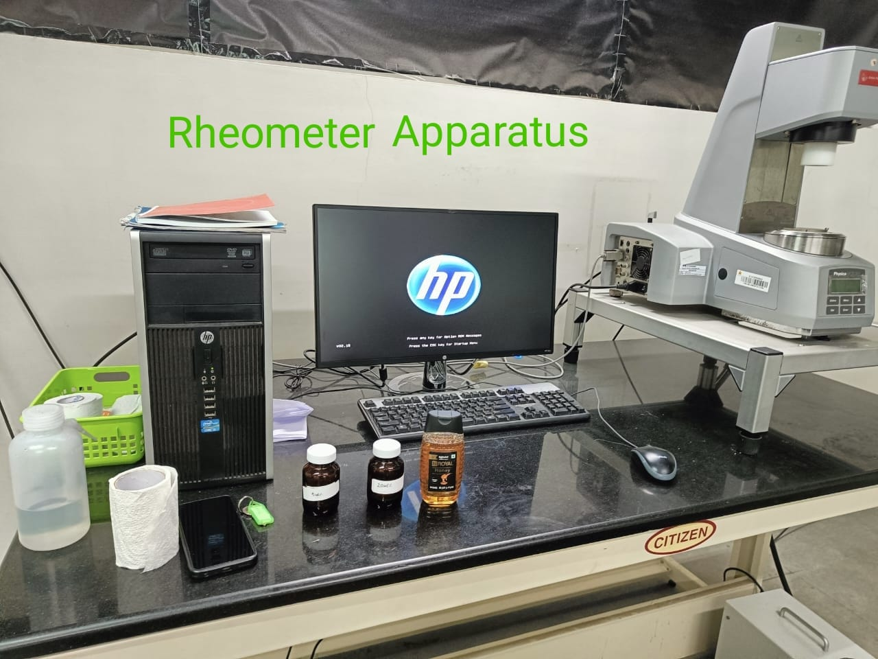
Apparatus
20wt% sugar syrup
5wt% sugar syrup
Honey
Magnetic stirrer
Rheometer
Beakers, Measuring cylinder
Spatula

Slide 5
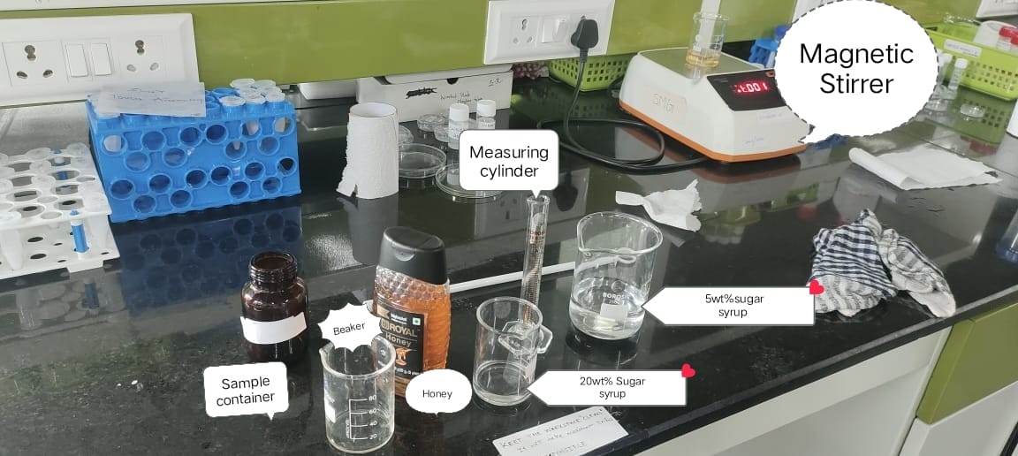

Slide 6
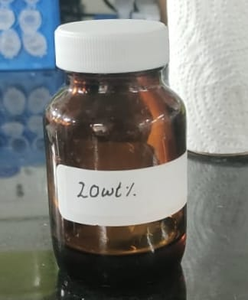
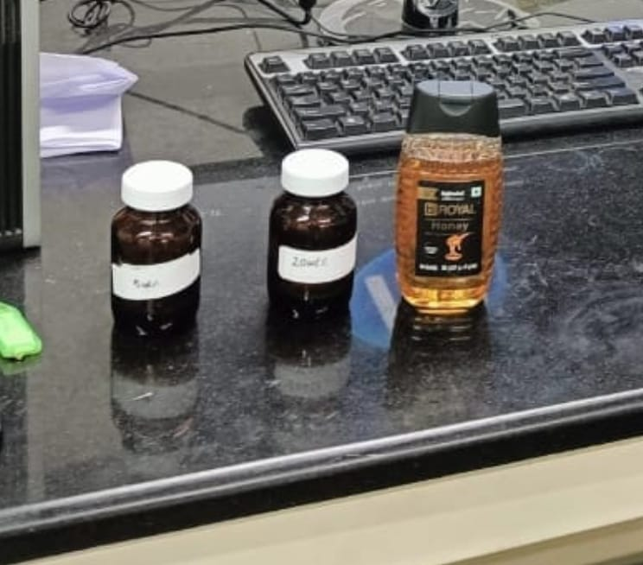
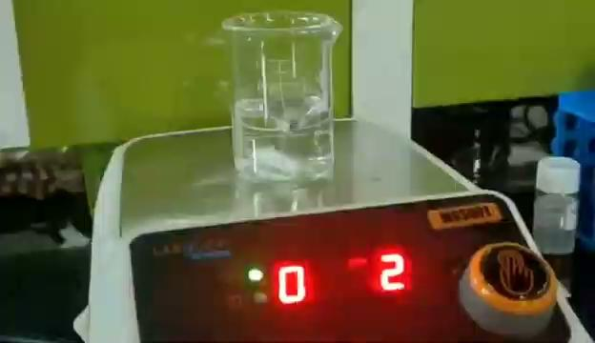
Sample Preparation
We made the 20 wt% sugar syrup by adding 10 grams of sugar with 40 ml of water.
We used Magnetic stirrer for 2 min at 400 rpm to uniformly mix the solution.
The half of the 20 wt% syrup was diluted by adding 75 ml of water to obtain a 5 wt% sugar syrup.
This gives us a 20 ml of 20 wt% sugar syrup and 95 ml of 5 wt% sugar syrup.
Honey to sugar syrup ratio in sample 3 : 2

Slide 7
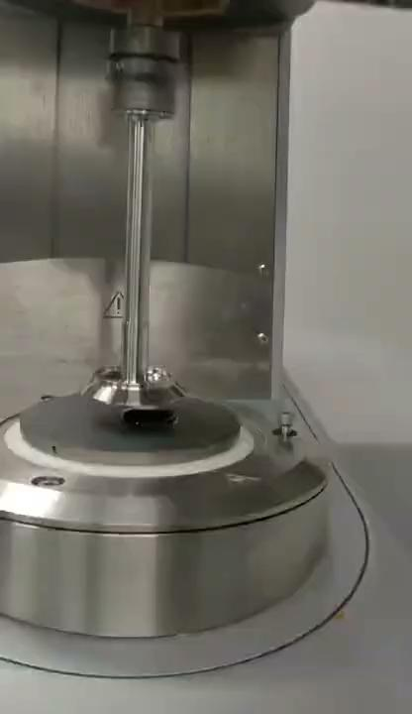
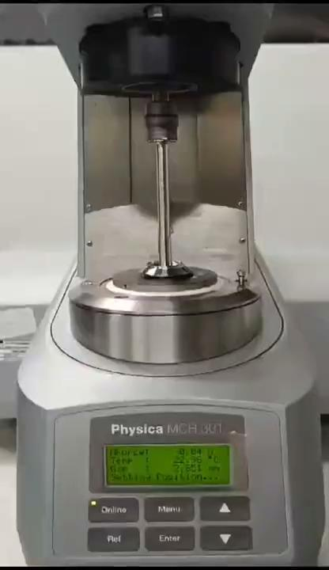
Procedure
Setted up the rheometer for shear rate analysis.
Loaded a small amount of Honey onto the measuring geometry [Parallel plate], ensuring it covers the entire surface.
Recorded data points for shear stress, viscosity, speed, and shear rate for Honey.
Repeated the measurements for honey mixed with 20% w/w sugar syrup and honey mixed with 5% w/w sugar syrup.
Analyzed and plotted the collected data to observe the rheological properties of each sample at different shear rates.

Slide 8
Hypothesis Vs Results

Slide 9
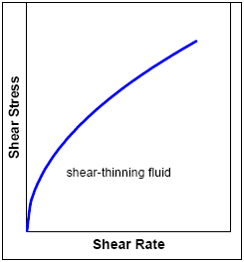
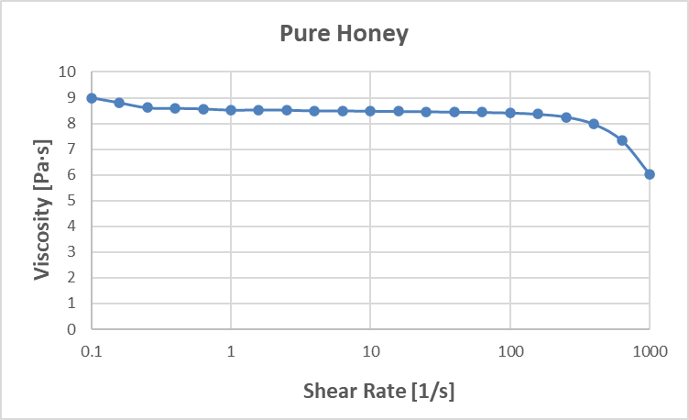
Hypothesis
Observed Result
The viscosity is decreasing as we are increasing the shear rate which is in favour of our hypothesis.
For Pure Honey We know that honey is a shear thinning liquid.

Slide 10
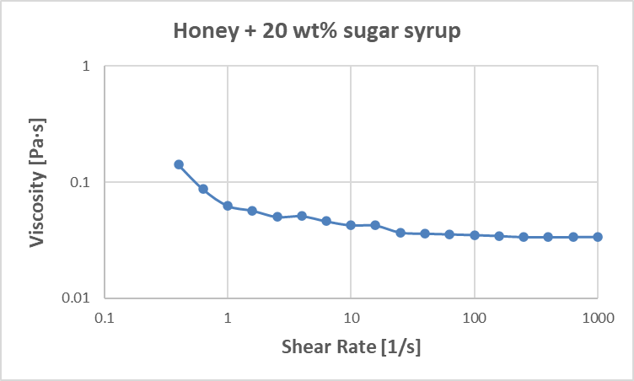
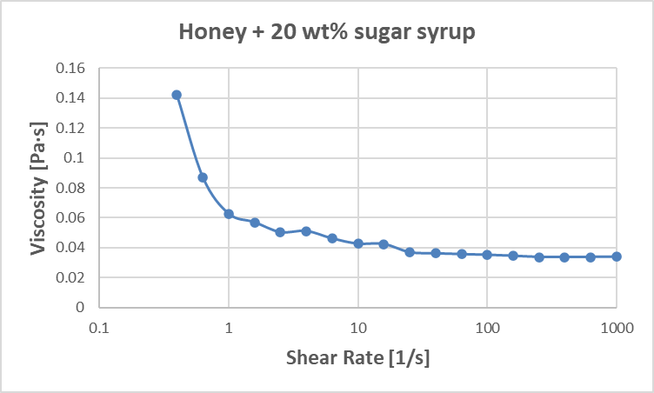
Hypothesis
Observed Result
For Honey + 20 wt% Sugar syrup
We can expect the viscosity of this sample mixture to decrease when compare to the pure honey for the same shear rates.
We can even expect that on higher shear rates the viscosity will become constant and behave as a newtonian fluid.

Slide 11
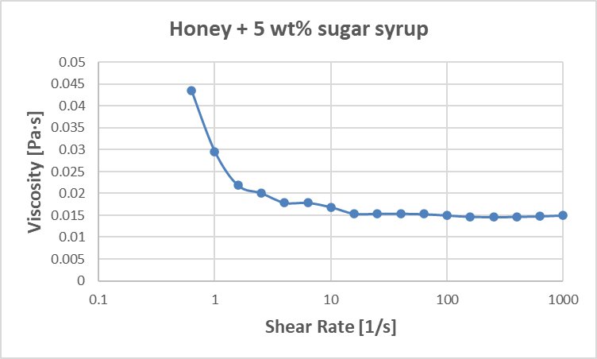
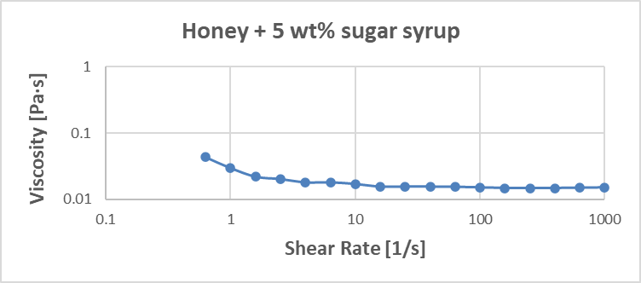
Hypothesis
Observed Result
For Honey + 5wt% Sugar syrup
We can expect the viscosity of this sample mixture to decrease even more when compared to 20 wt% honey for the same shear rates.
We can even expect that on higher shear rates the viscosity will become constant and behave as a newtonian fluid.

Slide 12
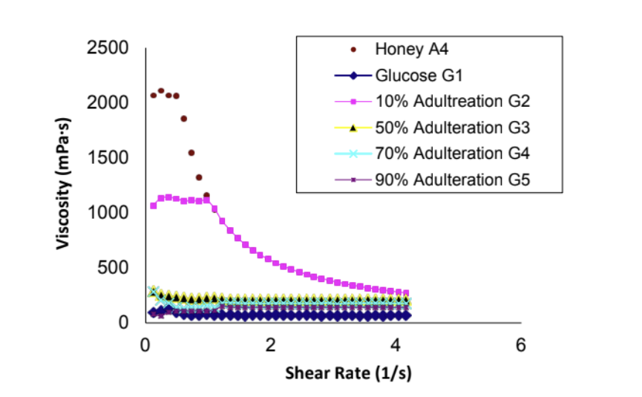
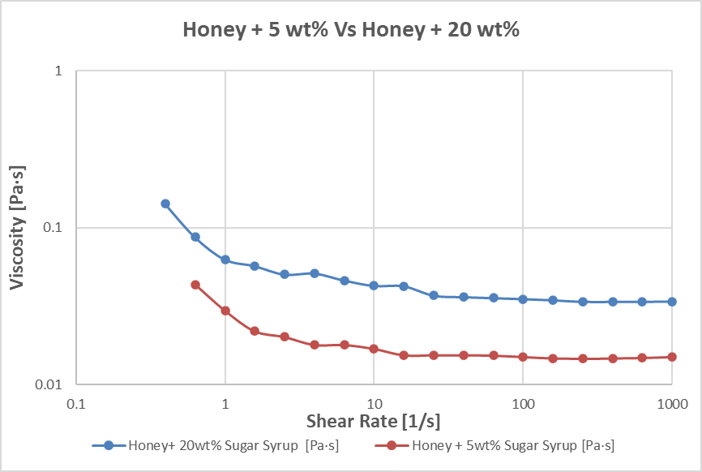
Conclusion
Based on this experiment we can conclude that trying to increasing the sugar content in the honey by adding sugar syrup in the ratio of 3:2 will lead us to more diluted samples which resulted to decreasing the viscosity of the samples. If we would have taken a different sample ratio we could expect different results.
Comparing Observed Data with Data from a research paper about adulterated Honey.

Slide 13
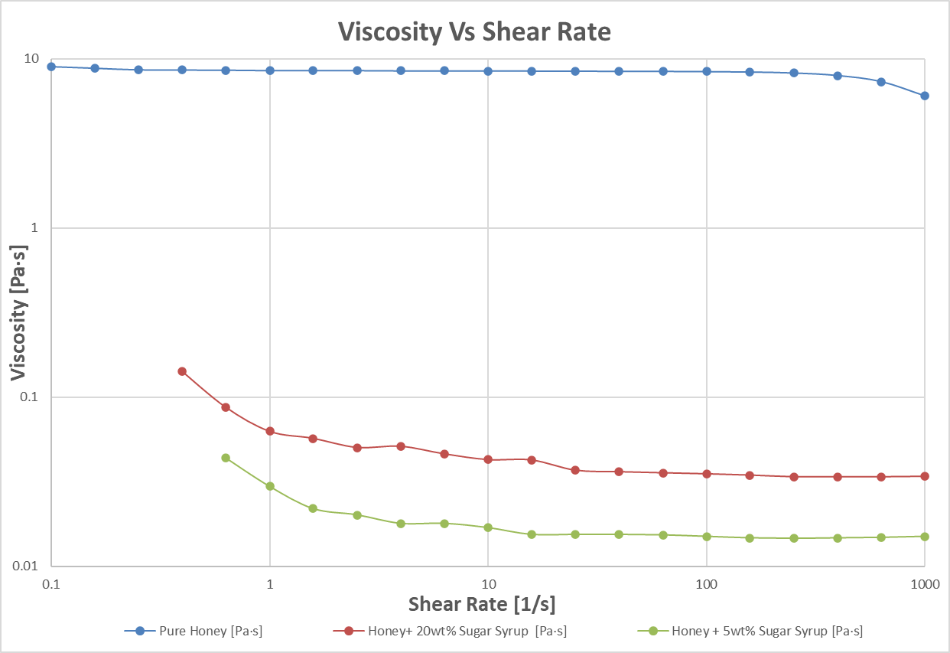

Slide 14
Improvements to the Experiment:
Considering More Concentration Levels
Changing ratio of Honey and Sugar syrup
Temperature Dependency
Extensional Rheometry

Slide 15
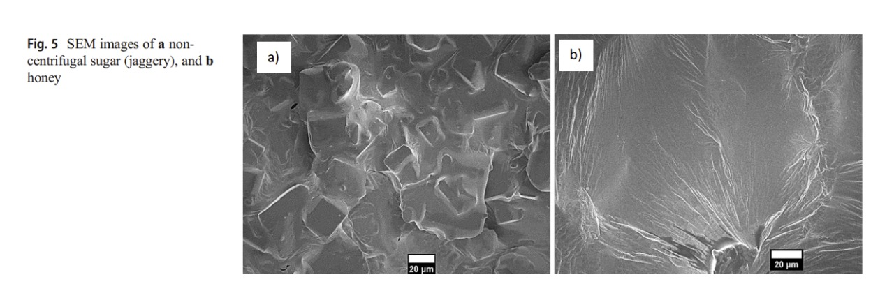
Microstructure of honey
A Novel Technique to Characterize and Quantify Crystalline and Amorphous Matter in Complex Sugar Mixtures link

Slide 16
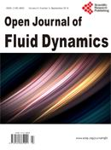
References:
Rheological Modeling of the Effects of Adulteration on Nigerian Honey, Open Journal of Fluid Dynamics link
Thank You…

